Slide 1
Pre-Calc & trig
Day 68

Slide 2
Bell Work
From Last Time:
Page 394 #1-7, 9-39 (odd)

Slide 3
6.6 Function Operations
Objective: To add, subtract, multiply, and divide functions To find the composite of two functions

Slide 4
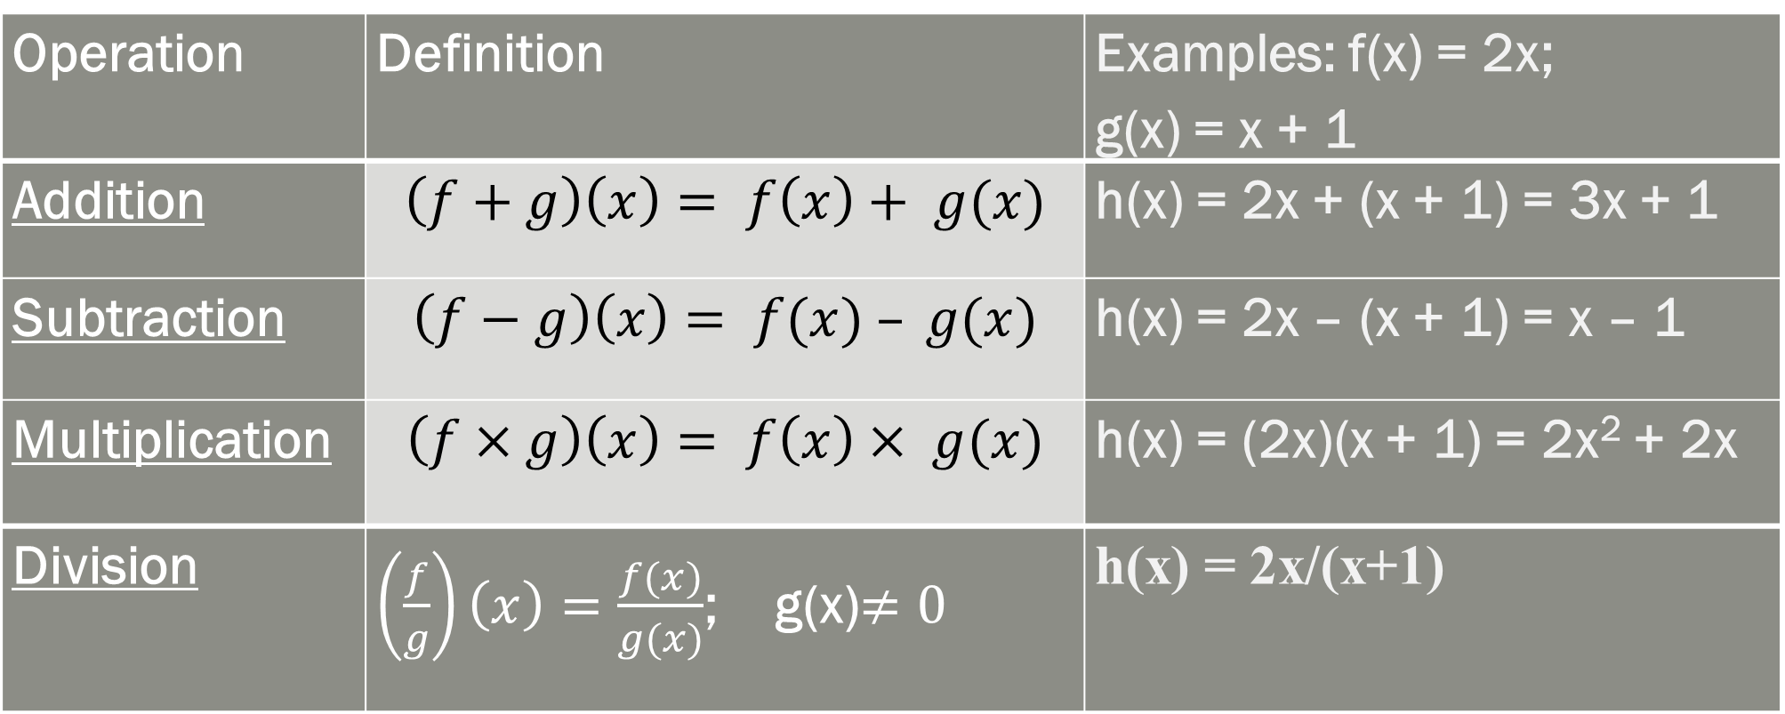
Operations on Functions; Let f and g be any two functions.
Operation | Definition | Examples: f(x) = 2x; g(x) = x + 1
Addition | $$\left(f+g\right)\left(x\right)= f\left(x\right)+ g(x)$$ | h(x) = 2x + (x + 1) = 3x + 1
Subtraction | $$\left(f−g\right)\left(x\right)= f(x) – g(x)$$ | h(x) = 2x – (x + 1) = x – 1
Multiplication | $$\left(f×g\right)\left(x\right)= f\left(x\right)× g(x)$$ | h(x) = (2x)(x + 1) = 2x² + 2x
Division | $\left(\frac{f}{g}\right)\left(x\right)=\frac{f(x)}{g(x)}$; g(x)$≠0$ | h(x) = 2x/(x+1)

Slide 5
Domain
Domain of h = the x-values that are in the domains of both f and g
The domain of a quotient does not include x-values for which the denominator = 0

Slide 6
Example
Perform each indicated operation, and state the domain.
f(x) + g(x); where f(x) = 3x³ – 2x² + 5x - 1 and g(x) = x² + 7x - 1

Slide 7
Example
Perform each indicated operation, and state the domain.
f(x) + g(x); where f(x) = 3x³ – 2x² + 5x - 1 and g(x) = x² + 7x - 1
f(x) + g(x); (3x³ – 2x² + 5x – 1) + (x² + 7x – 1) = 3x³ – 2x² + 12x – 2
Domain is all real numbers

Slide 8
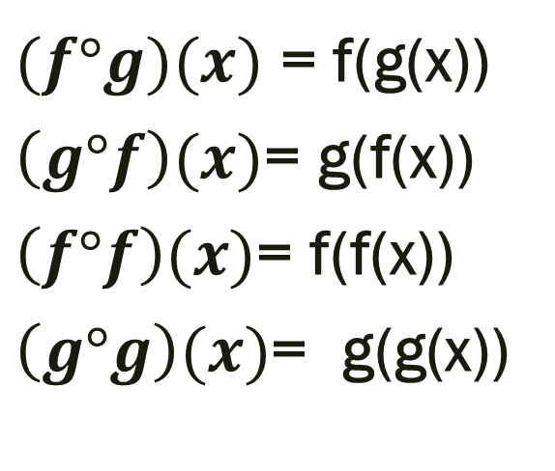
Composition of Two Functions;
$(f°g)(x)$ = f(g(x))
$\left(g°f\right)(x)$= g(f(x))
$\left(f°f\right)(x)$= f(f(x))
$\left(g°g\right)(x)$= g(g(x))
Note: For f(g(x)): substitute g(x) for x in the function f(x)…
In general, f(g(x)) ≠ g(f(x)) (although it is possible, this would just be a coincidence)

Slide 9
Example: Let f(x) = 4x and g(x) = x -1. Perform the indicated operation and state the domain.
a) f(g(x)) b) g(f(x))
c) f(f(x)) d) g(g(x))

Slide 10
Example: Let f(x) = 4x and g(x) = x -1. Perform the indicated operation and state the domain.
a) f(g(x)) b) g(f(x))
plug the g into f plug the f into g
4(x-1)=4x-4 (4x)-1=4x-1
c) f(f(x)) d) g(g(x))
plug the f into f plug the g into g
4(4x)=16x (x-1)-1 = x-2

Slide 11
6.7 Inverse Relations and Functions
Objective: To find the inverse of a relation or function
Inverse Relation: maps the output values back to the original input values (x’s and y’s switch)
The domain of the inverse relation is the range of the original relation, and the range of the inverse relation is the domain of the original relation

Slide 12
Inverse Functions: when the inverse and original relations are both functions, then they are inverse functions of each other
Finding the Inverse Relation;
Switch x and y in the original relation
Solve for y (if possible)

Slide 13
Find an equation for the inverse of the given relation: y = 2x – 4

Slide 14
Find an equation for the inverse of the given relation: y = 2x – 4 x = 2y – 4 x + 4 = 2y (x + 4)/2= y

Slide 15
Inverse Functions; Functions f and g are inverses of each other provided: f(g(x)) = x and g(f(x)) = x The function g is denoted by f⁻¹, read as “f inverse”

Slide 16
Verify that f and g are inverse functions:
f(x) = x + 7 and g(x) = x – 7
f(x) = 2x – 4 and

Slide 17
For Next Time
6.6 page 401 #1-13, 15-35 (odd), 36-38
6.7 page 409 #9-21 (odd), 37

